Slide 1
D&D CONVEYOR
SRI SAIRAM INSTITUTE OF TECHNOLOGY
-PERARASU S
-SATHYA NARAYANAN P
-SAKTHIVEL V

Slide 2
TABLE OF CONTENT
PROBLEM STATEMENT
ABSTRACT
STAT ABOUT D&D PEOPLE
LITERATURE SURVEY-1
LITERATURE SURVEY-2
EXISTING SYSTEM
PROPOSED SYSTEM
BLOCK DIAGRAM
HARDWARE&SOFTWARE
BUSINESS MODEL

Slide 3
PROBLEM STATEMENT
Individuals who are both deaf and mute encounter significant challenges in communicating their thoughts, feelings, and needs effectively. Existing solutions often fall short in providing them with accessible and efficient means of communication, leading to social isolation and limited participation in various aspects of life.

Slide 4
ABSTRACT
Deaf and dumb people use sign language for communication but they find difficulty in communicating with others who don’t understand sign language. So, there is a need a translator to understand what they speak and communicate with us. The pictures of hand gesture are labeled data preprocessed by the supervised learning . The sign language translation system translates the normal sign language to speech and hence makes the communication between normal person and dumb people easier. So, the whole idea is to build a communication system that enables communications between speech-hearing impaired and a normal person.

Slide 5
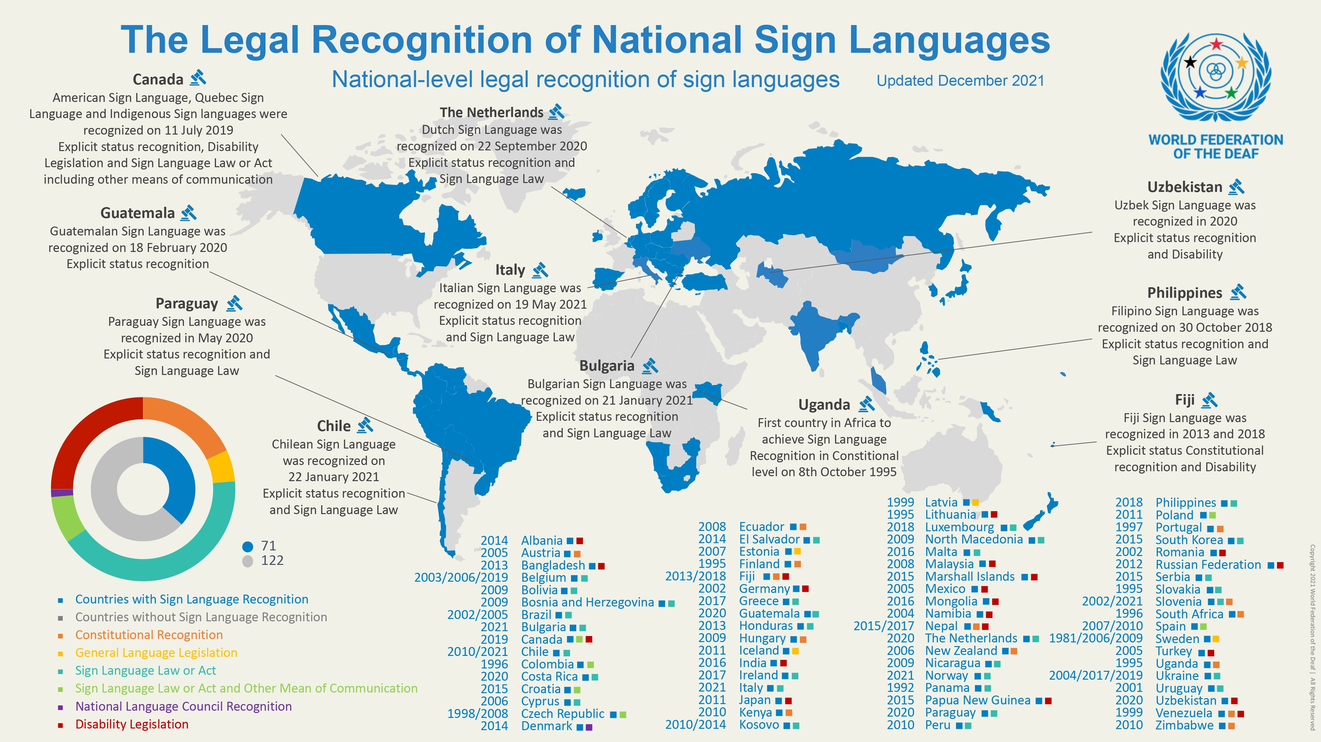
STATS ABOUT D&D CONVEYOR
*According to a survey, 2.42M people are deaf and dumb people in India that large amount in the society. Overall the world is having around 15 -20 % of the deaf and dumb population

Slide 6
LITERATURE SURVEY-1
Title :D&D Conveyor
Base Paper : Deaf and Dumb Gesture Recognition System
Author : Vaibhav Shah, Nikhil Sharma, Prince Solanki, Prof. Hemalata Mote
Through this project we are trying to build flexible system for the physically impaired people that will ease their life. An attempt tocreate a sign language to text conversion wireless lightweight system, through the use of information gestured by physically impaired person which can be effectively conveyed to a normal person.The system will try to convert the sign language of the
physically impaired person into text that can interpreted by their own genre and also to the rest of the world.

Slide 7
LITERATURE SURVEY-2
TITLE:- D&D Conveyor
Base Paper:-A Novel Machine Learning Based Two-Way CommunicationSystem for Deaf and Mute
Author:- Muhammad Imran Saleem , Atif Siddiqui, Shaheena Noor , Miguel-Angel Luque-Nieto and Pablo Otero .
They used speech-to-text, speech-to-visual, and sign language features in their implementation . This application works in offline mode. They have implemented American Sign Language(ASL) and Indian Sign Language(ISL). an application is developed for DnM , which detects facial emotion. The application performs eye-tracking and event related potential analysis.

Slide 8
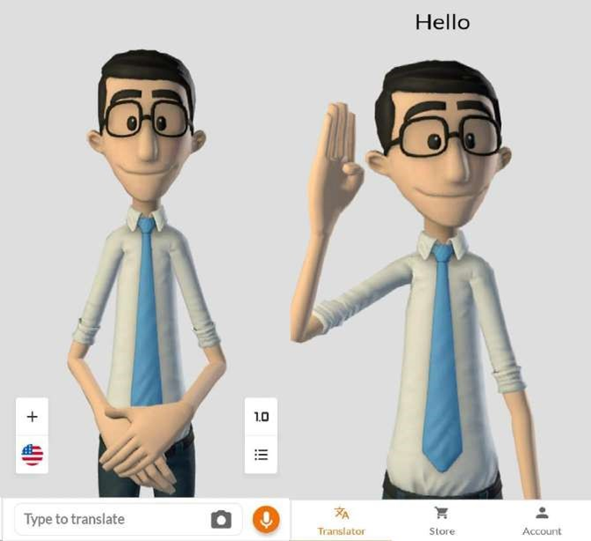
EXISTING SYSTEM
Translating Method:
The application only translate the text format to the hand gestures . It does not do the reverse process . And also it basically in a American and brazilian sign languages .
Environment Of The App:
This app is in a 3D animated .the text we send that and
the character is do some sign languages.
Language Used In App:
The app is using only two mode of sign languages it does not contain our language.

Slide 9
PROPOSED SYSTEM
Algorithm Used:
The images of the hand signals are preprocessed by the algorithm of convolutional neural network(CNN) . The processed images are then identify by the deep learning.
Both Format:
The text can be converted into video and also audio format and vice versa. It consist of Indian sign language and also it comes in a offline mode.
Emotions Detected:
It can detect the face emotions with the help of ML which is used to more accuracy of the prediction of the signals.
Communication using sign language or manual communication boards can provide a visual and deliberate means of interaction, allowing for clear and precise communication that fosters patience and deeper understanding among participants, leading to more thoughtful and meaningful exchanges in various situations.
Widespread adoption of such technology can increase awareness and sensitivity to the needs of the deaf and mute community, fostering a more inclusive society.

Slide 10
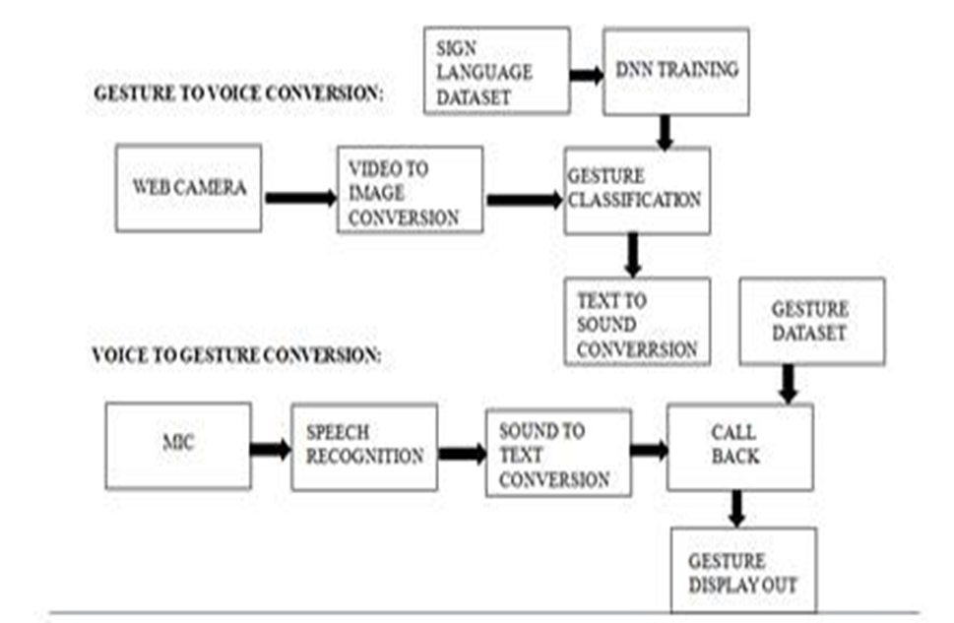
BLOCK DIAGRAM

Slide 11
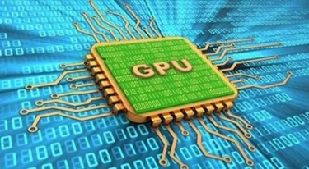
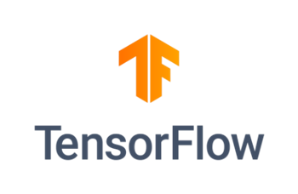

HARDWARE & SOFTWARE
SOFTWARE:
Deep Learning Framework: TENSORFLOW
Python Programming Language
Machine Learning Deployment Framework (Optional):
Flutter
HARDWARE:
Central Processing Unit (CPU):
Graphics Processing Unit (GPU):

Slide 12
